Slide 1
BEST OF Middle Grade 2015

Slide 2
Erin Downey Howerton
WPL, YALSA, Booklist
@hybridlib
Slides available at hybridlib.net
goodreads.com/erindowney

Slide 3





Brilliant
Roddy Doyle
Gr. 4-6
Gr. 5-8
Ages 8-12
Ages 8-12

Slide 4


A Nearer Moon
Melanie Crowder
Gr. 3-5
Gr. 5-8
Ages 8-12
Ages 9-12

Slide 5

The War That Saved My Life
Kimberly Brubaker Bradley
Gr. 5-8
Gr. 4-6
Ages 9-12
Ages 8-12

Slide 6

Adam & Thomas
Aharon Appelfeld
Gr. 5-8
Gr. 4-6
Ages 8-12
Ages 10-18

Slide 7

The Imaginary
A.F. Harrold
Gr. 4-6
Gr. 4-7
Ages 8-12
Ages 9-13

Slide 8

George
Alex Gino
Gr. 4-6
Gr. 4-6
Ages 8-12
9-12

Slide 9
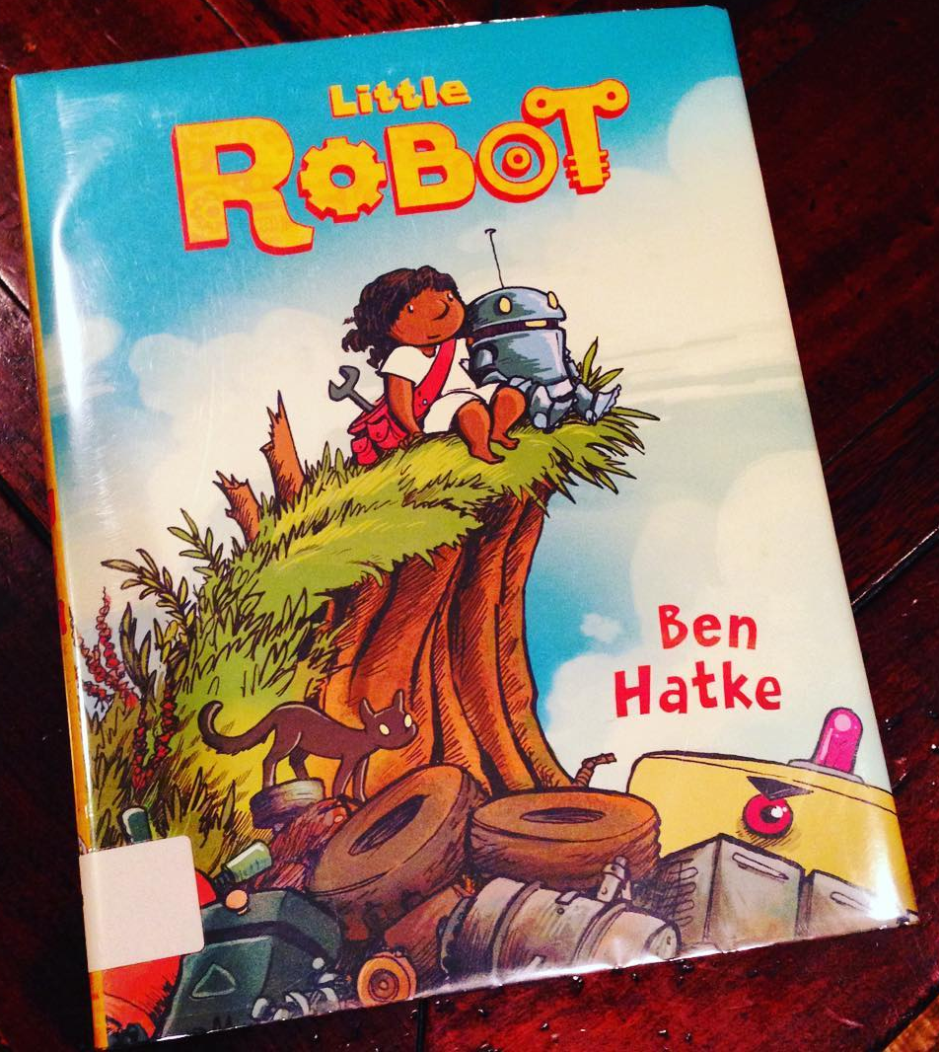
Little Robot
Ben Hatke
Gr. 1-4
Gr. 2-4
Ages 6-9
Ages 3-12

Slide 10

Full Cicada Moon
Marilyn Hilton
Gr. 4-7
Gr. 4-8
Ages 8-12
Ages 8-12

Slide 11

Sunny Side Up
Jennifer & Matthew Holm
Gr. 3-7
Gr. 4-6
Ages 8-12
Ages 9-11

Slide 12


Roller Girl
Victoria Jamieson
Gr. 4-8
Gr. 4-8
Ages 9-12
Ages 9-13

Slide 13

The Boy Who Harnessed the Wind
William Kamkwamba
?????
Gr. 4-7
Ages 11-16

Slide 14

Stormstruck!
John Macfarlane
Gr. 4-7
Gr. 3-5
Ages 8-12

Slide 15

In the Footsteps of Crazy Horse
Joseph Marshall III
Gr. 4-6
Gr. 4-8
Ages 10-14
Ages 9-12

Slide 16

School for Sidekicks
Kelly Mccullough
Gr. 4-7
Gr. 4-6
Ages 10-14
Ages 11-13

Slide 17

The Octopus Scientists
Sy Montgomery
?????
Gr. 6-9
?????
Ages 10-16

Slide 18

The First Case
Ulf Nilsson
Gr. 2-4
Gr. 1-4
Ages 7+
Ages 4-10

Slide 19

The Seventh Most Important Thing
Shelley Pearsall
Gr. 5-8
Gr. 4-7
Ages 10-14

Slide 20

Echo
Pam Muñoz Ryan
Gr. 5-8
Gr. 5-8
Ages 10-14
Ages 9-14

Slide 21

The Blackthorn Key
Kevin Sands
Gr. 4-7
Gr. 4-6
Ages 10-14
Ages 8-12

Slide 22

Funny Bones:
Posada and His
Day of the Dead Calaveras
Duncan Tonatiuh
Gr. 3-5
Gr. 3-6
Ages 6-10
Ages 7-13

Slide 23

HiLo:
The Boy Who Crashed to Earth
Judd Winick
Gr. 2-5
Gr. 2-5
Ages 8-12
Ages 7-12

Slide 24

Last Stop on Market Street
Matt de la Peña
Pre-k-Gr. 2
K-Gr. 2
Ages 3-5
Ages 3-6

Slide 25

Trombone Shorty
Troy Andrews
Ill. Bryan Collier
?????
Gr. 1-4
Ages 4-8
Ages 4-8

Slide 26


The Wonderful Fluffy Little Squishy
Beatrice Alemagna
K-Gr. 2
PreK-Gr. 2
Ages 4-8

Slide 27

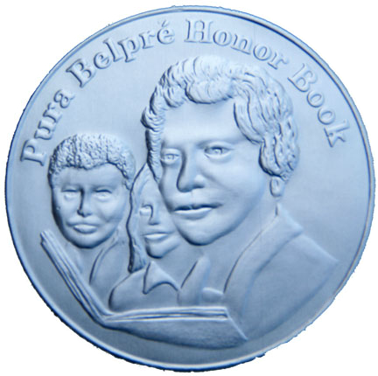

The Smoking Mirror
David Bowles

Slide 28

The Boys Who Challenged Hitler:
Knud Pedersen and the Churchill Club
Phillip Hoose
Gr. 7-10
Gr. 9+
Ages 12-18
Ages 12-18

Slide 29

Waiting
Kevin Henkes
PreK -K
PreK-K
Ages 4-8
Ages 3-6

Slide 30

28 Days:
Moments in Black History
that Changed the World
Charles Smith
Ill. Shane Evans
Gr. 2-4
Gr. 2-5
Ages 4-10
Ages 4-10

